Slide 1
2D Stencil Project PART 2 Movie
CSCI 209
Spring 2024
NOTE – IN JAVA ‘-’ (hyphens) are not allowed in class names, so you will need to use underscores ‘_’

Slide 2
PART 2
Fix anything that you noticed was wrong about your implementation for Part 1.
Make sure that you have python script that can reproduce all the results and can gather the data to produce the plots programmatically
Then make a new version of stencil-2d like this
./stencil-2d-all <number of iterations> <initial state> <final state> <all frams output file>
Where all is like I described in class (3 pieces of int metadata rows, cols and #total frames, followed up the row-major frames for #iterations + 1 number of frames.
python generate_movie.py <all frames file> <movie output file>
Where the all frames file is the one that came out of the prior program and where the movie it drops out is a movie of all the frames and also the program will pop up an interface
Fix and make more of the fact that the data is to be big-Endian binary data and that the python scripts should be updated to make sure that will be the case regardless of M2 Versus x86 architecture.

Slide 3
Submission
Make sure you update everything – and make a small movie (<10 MB in size> to include in your submission
Update PPT, etc.

Slide 4
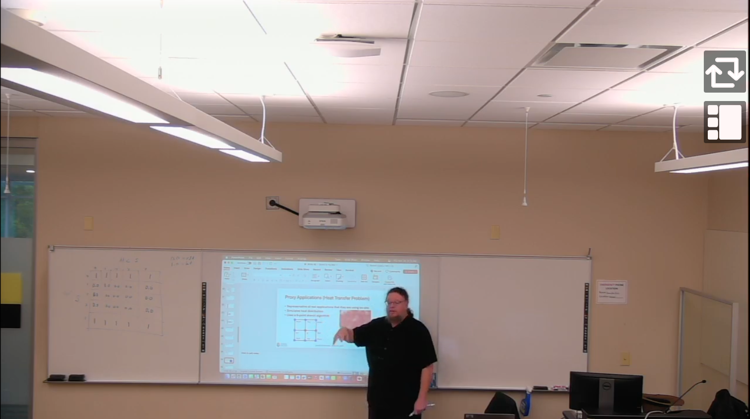
This assignment was discussed in class March 28, 2024
YUJA VIDEO FROM CLASS DISCUSSING ASSIGNMENT
Got back and watch this to review what is needed / why and how it works.

Slide 5
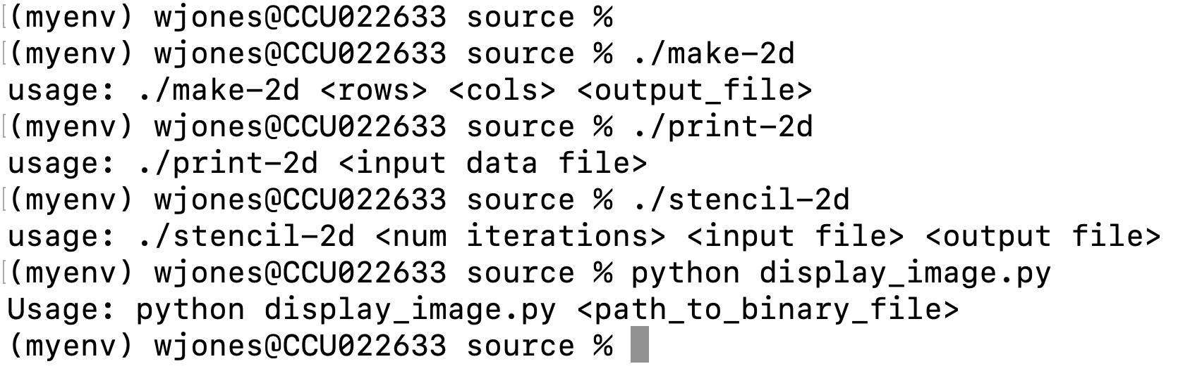

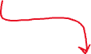

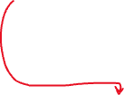
Interface / Workflow
NOTE – IN JAVA ‘-’ (hyphens) are not allowed in class names, so you will need to use underscores ‘_’
You’ll need to run it with the java JVM of course
USE UNDERSCORES INSTEAD
(except of course, it needs to be in java for all but the last one)

Slide 6
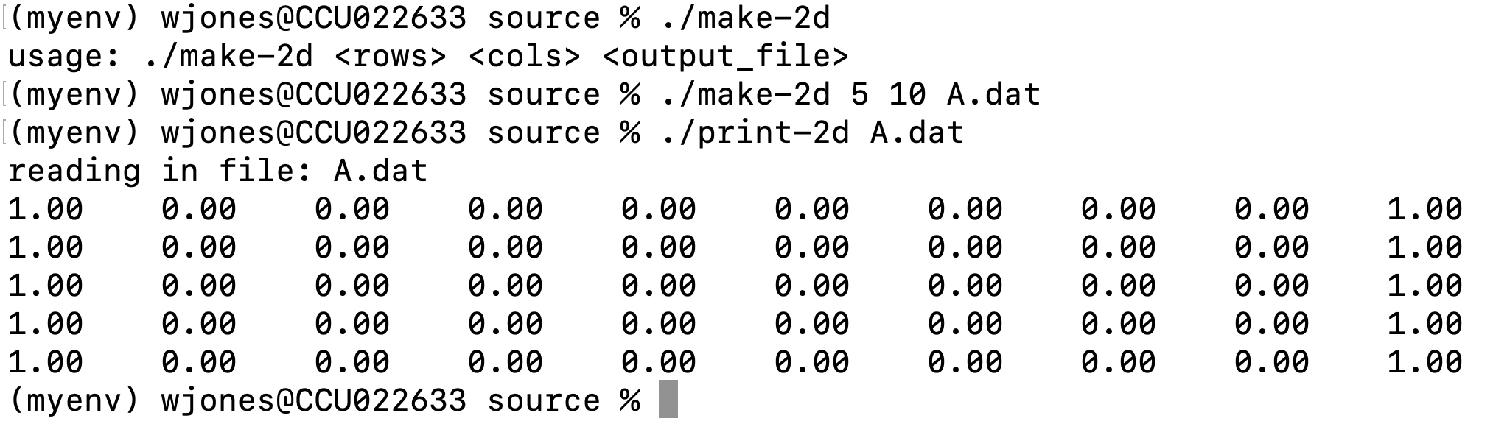


Making example (small) file
USE UNDERSCORES INSTEAD
(boundaries never change, only the interior cells)
Interior cells

Slide 7
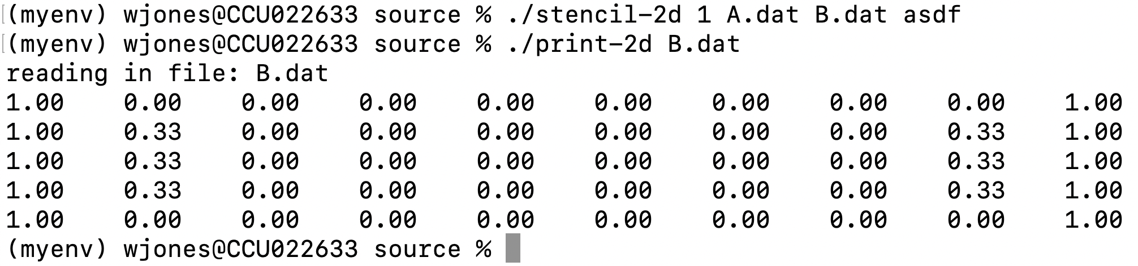

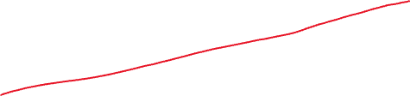


Running 1 iteration of the stencil algorithm
USE UNDERSCORES INSTEAD
Notice the changes in the cells here

Slide 8
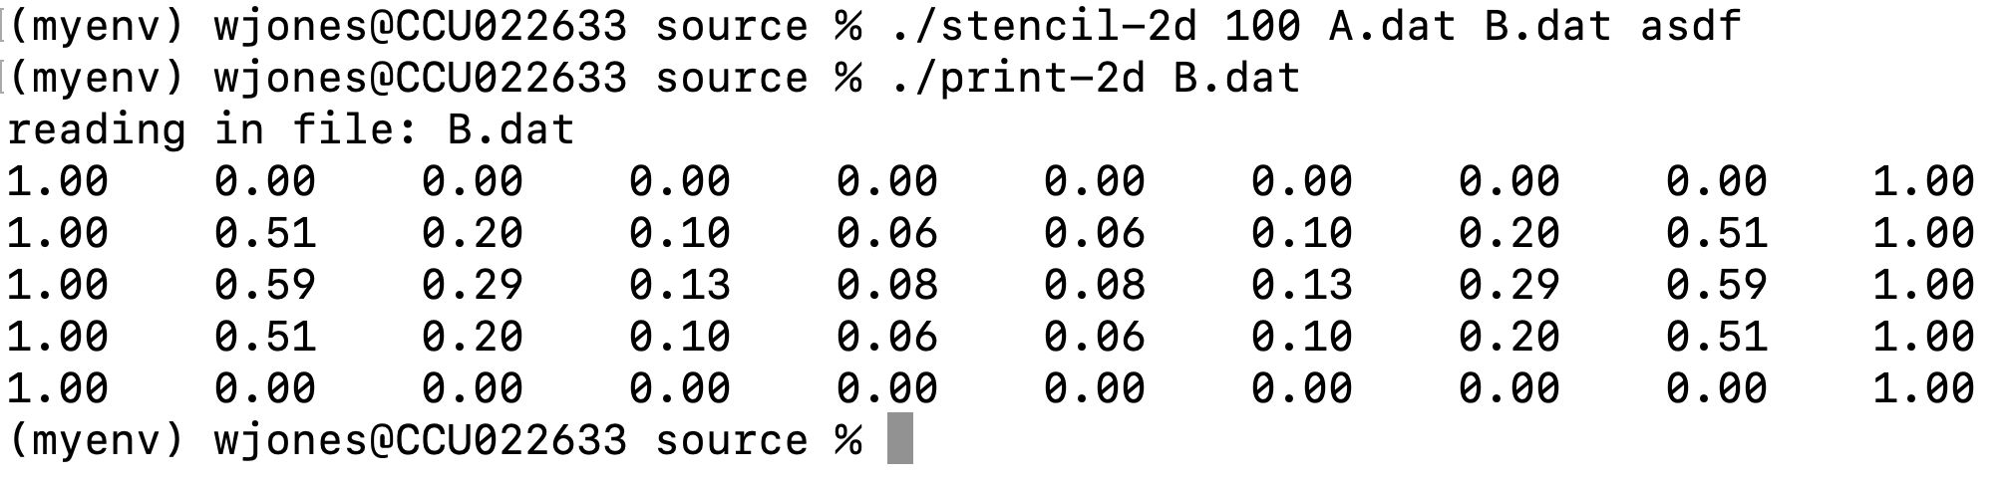


Running 100 iteration of the stencil algorithm
USE UNDERSCORES INSTEAD
Notice the MORE changes in the cells here

Slide 9
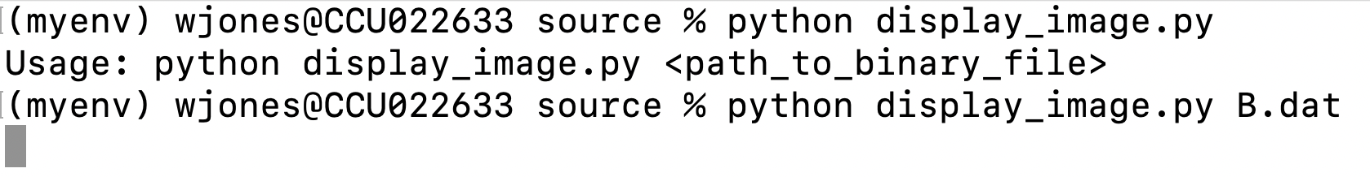
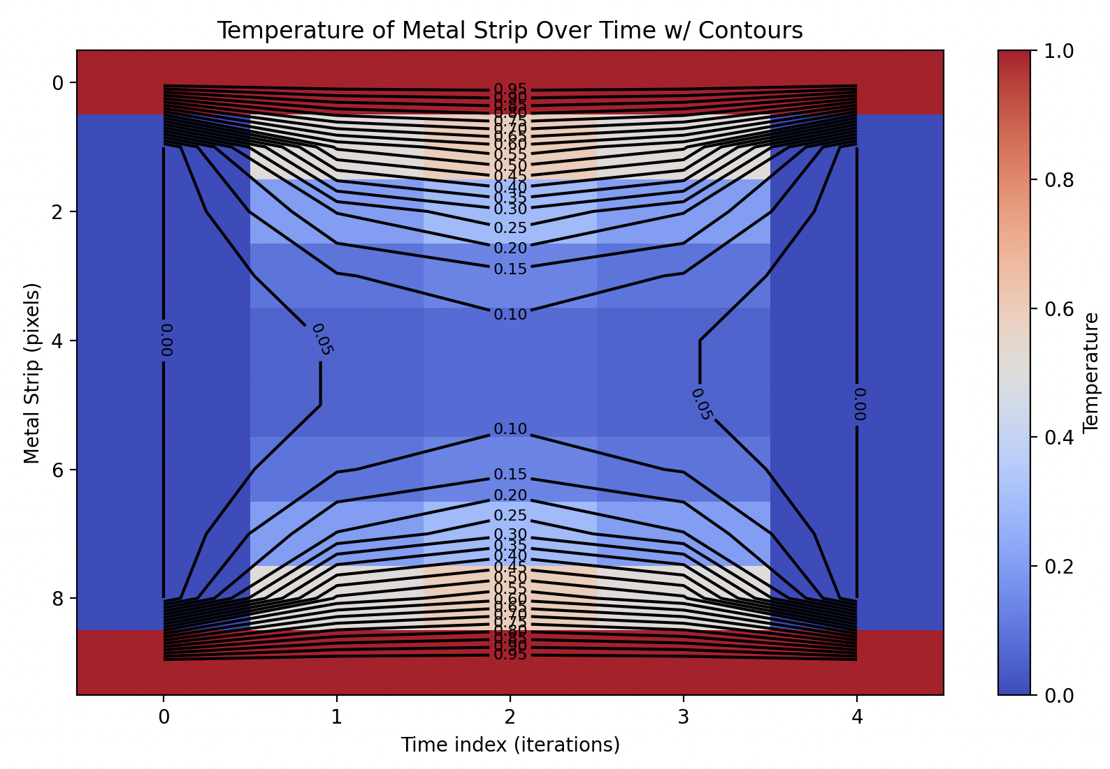
Visualization Prior B.dat (final state) w/ Python
USE UNDERSCORES INSTEAD
Matplotlib will be useful
Google how to do this
Google how to add contours
Make sure to label axes

Slide 10
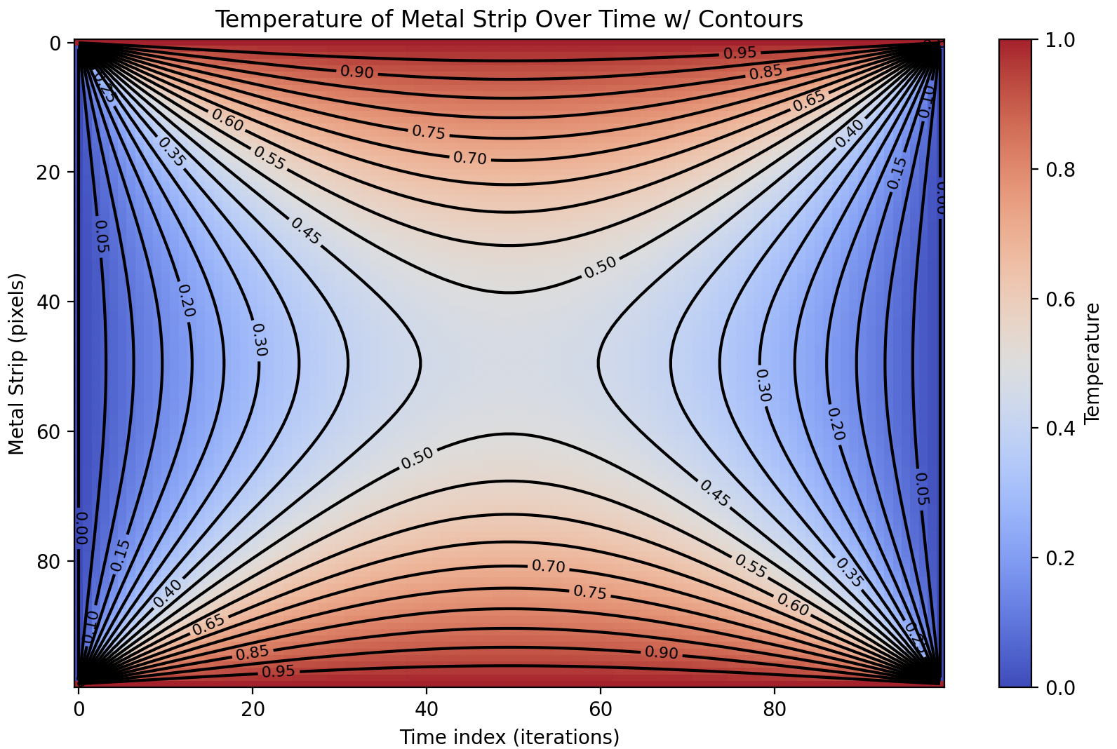
Operation with 100x100 @ 5K iterations
USE UNDERSCORES INSTEAD

Slide 11
Timing and performance
Timing
Measure overall, work, and IO time
Run a few sizes of N (all powers of two between 128 and 2048, inclusive) where the number of iterations is set to 100 and measure these times and plot them, X axis is N and Y axis is time. There should be 3 curves. Use a python script, called plot_data.py to plot this (not shown in class)

Slide 12
Submission
There will be a folder structure, like discussed in class
./hw07-P1
./code // java and python scripts here
./data
./report // PPT report (not Word)
Make a detailed report (PPT) discussing everything, showing it working, results, etc. Prove that it can do everything that I mentioned in class. Zip and submit to Moodle.

